Slide 1
Video Games Sales
Lesson 6

Slide 2
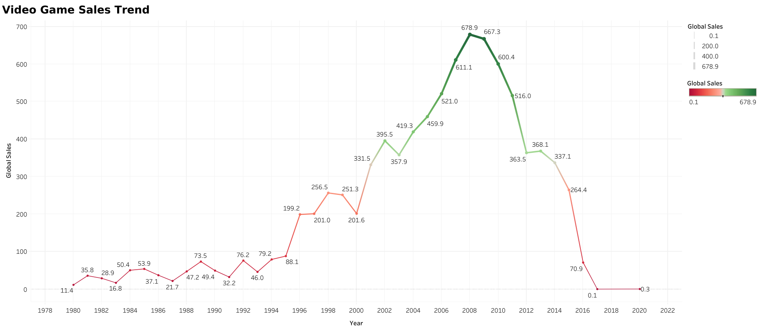
Overall, sales have decreased sharply since 2012

Slide 3
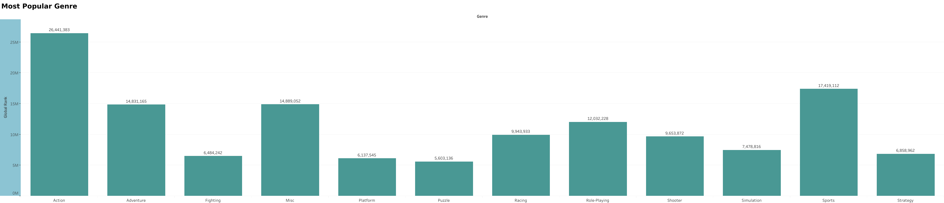
Action is largely the most popular genre

Slide 4
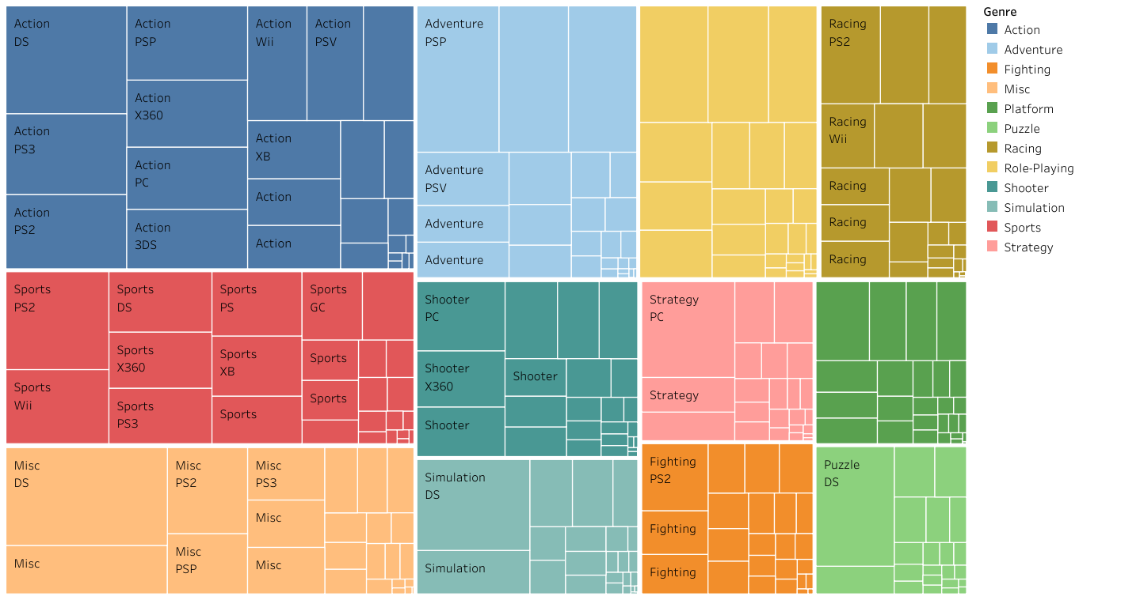
Comparing Platforms by Genre

Slide 5
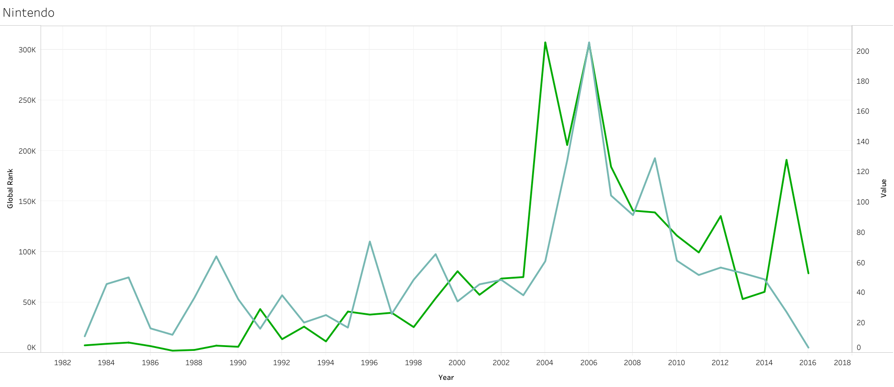
Nintendo's Rank and Global Sales Trend
Sales
Rank

